Slide 1
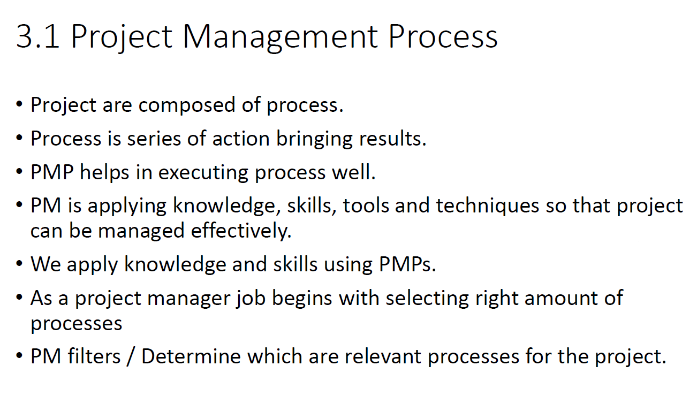

Slide 2
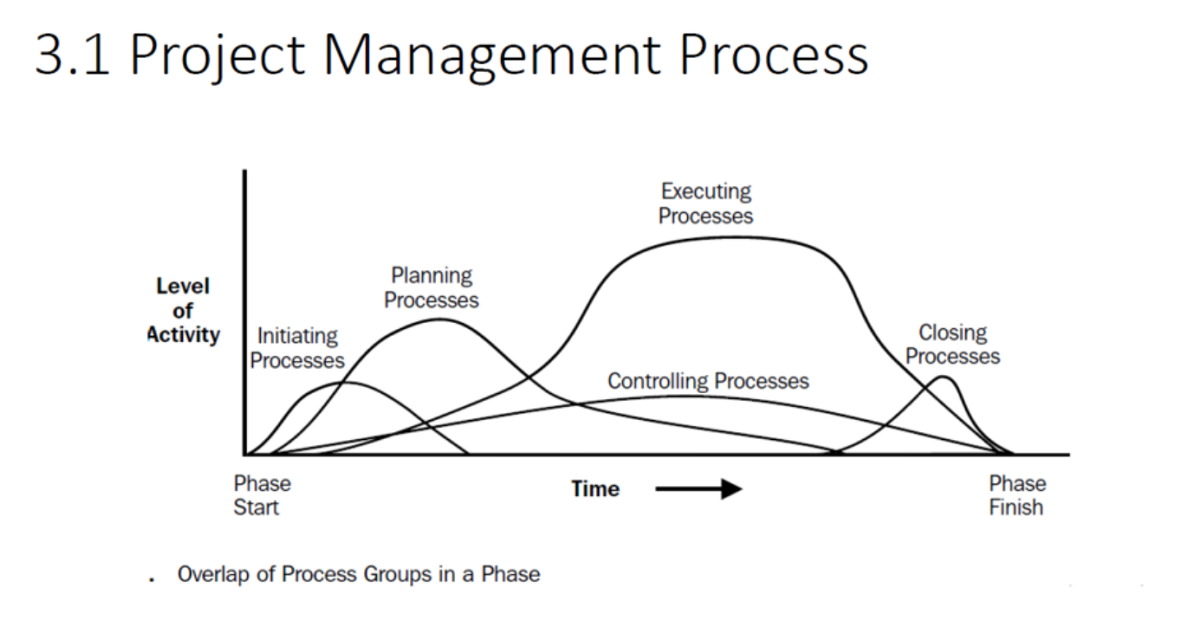

Slide 3
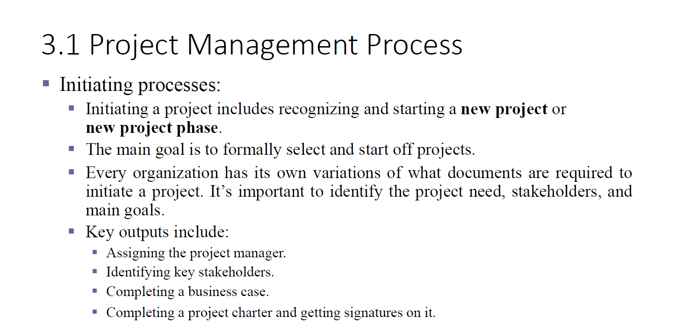


Slide 4
Project Planning
The Project Planning phase is a critical component of the project management life cycle, and it involves defining, refining, and documenting the project scope, objectives, and strategies for achieving those objectives.
Develop Project Management Plan
Create a comprehensive Project Management Plan that defines how the project will be executed, monitored, and controlled
Plan Scope Management
Define how project scope will be defined, validated, and controlled throughout the project. This includes creating a scope statement, a work breakdown structure (WBS)
Collect Requirements
Gather and document stakeholder needs and requirements through various methods such as interviews, surveys, and focus groups. These requirements will help shape the project scope.
Define Scope
Develop a detailed project scope statement based on the collected requirements. Clearly outline what is included and excluded from the project.
Create Work Breakdown Structure (WBS)
Decompose the project into smaller, more manageable components using a hierarchical WBS. This helps in organizing and understanding the scope of work.

Slide 5
Project Planning
Plan Schedule Management
Define how the project schedule will be created, executed, and controlled. This includes identifying milestones, activities, dependencies, and resource requirements.
Define Activities
Identify and document the specific activities that need to be performed to produce the project deliverables. This involves breaking down the work packages from the WBS into detailed tasks
Sequence Activities
Establish the order and dependencies among project activities. This helps create a logical flow of work and determines the project schedule.
Estimate Activity Durations
Estimate the time required to complete each project activity. This involves considering factors such as resource availability, skill levels, and historical data.
Develop Schedule
Create the project schedule by analyzing activity sequences, durations, and resource requirements. The output is a project schedule that includes start and finish dates for each activity.
Plan Cost Management
Define how the project costs will be estimated, budgeted, managed, and controlled. This involves creating a cost management plan.

Slide 6
Project Planning
Plan Quality Management
Define how quality will be planned, assured, and controlled throughout the project. Develop a quality management plan that outlines the standards and processes to be used.
Plan Resource Management
Define how project resources, including human resources, equipment, and materials, will be acquired, developed, and managed
Estimate Activity Resources
Estimate the type and quantity of resources required for each project activity. This includes personnel, equipment, and materials.
Plan Communications Management
Define how project communications will be planned, distributed, and managed. Develop a communications management plan that outlines the communication requirements and expectations
Plan Risk Management
Establish how risks will be identified, assessed, and managed throughout the project. Develop a risk management plan that includes risk identification, analysis, response planning, and monitoring.
Plan Procurement Management
Define how project procurement will be managed, from planning through contract closure. Develop a procurement management plan that outlines the procurement requirements and processes.

Slide 7
Key Outputs from Planning Phase:
Project Management Plan: Comprehensive document outlining how the project will be executed, monitored, and controlled.
Scope Statement: Clearly defining the project's scope, objectives, constraints, and acceptance criteria.
Work Breakdown Structure (WBS): Hierarchical decomposition of the total scope of work to be carried out by the project team.
Project Schedule: Timeline of project activities, including start and finish dates for each task.
Cost Estimate and Budget: Estimated costs for project activities and an authorized budget.
Quality Management Plan: Outlining how quality will be planned, assured, and controlled.
Resource Management Plan: Describing how resources, including human resources, equipment, and materials, will be acquired, developed, and managed.
Communications Management Plan: Defining how communication will be planned, distributed, and managed.
Risk Management Plan: Outlining how risks will be identified, assessed, and managed throughout the project.
Procurement Management Plan: Describing how project procurement will be managed, including contracts and vendor relationships.
Stakeholder Engagement Plan: Defining strategies for effectively engaging stakeholders throughout the project.

Slide 8
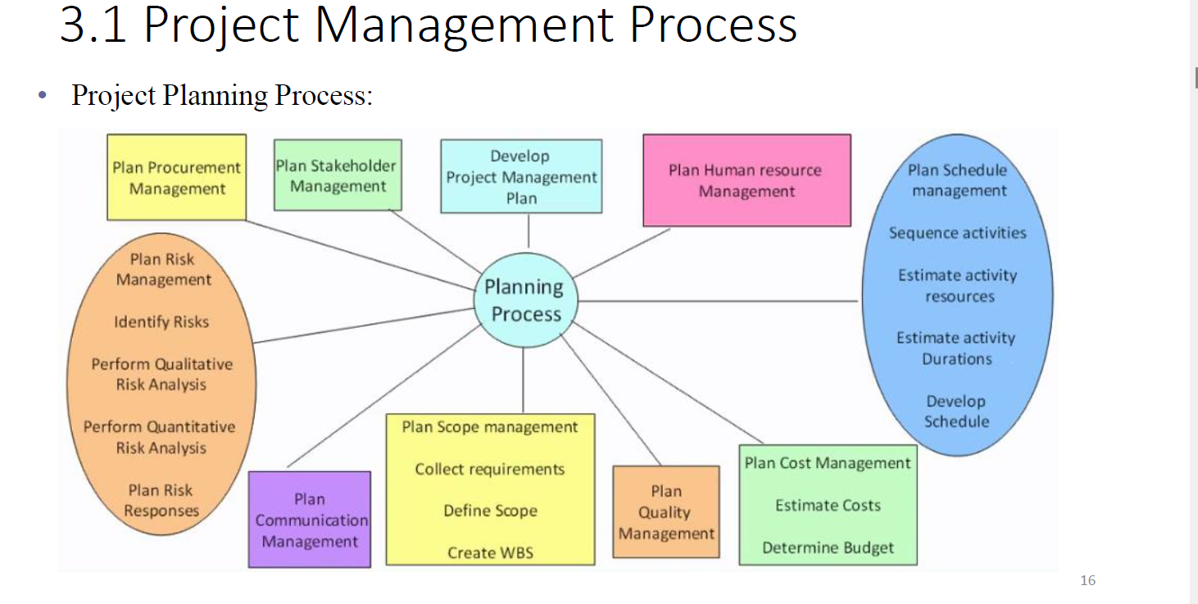

Slide 9
Work Breakdown Structure (WBS)
The Work Breakdown Structure (WBS) is a fundamental tool in project management that breaks down a project into smaller, more manageable components.
Define the Project Scope:
Clearly understand and define the overall scope of the project.
Identify Major Deliverables:
Break down the project into major deliverables or work packages. These are the high-level components that represent significant achievements in the project.
Decompose Major Deliverables
Break down each major deliverable into smaller, more manageable sub-deliverables. Continue this process until you reach a level where work can be easily understood and assigned to a specific team or individual.

Slide 10
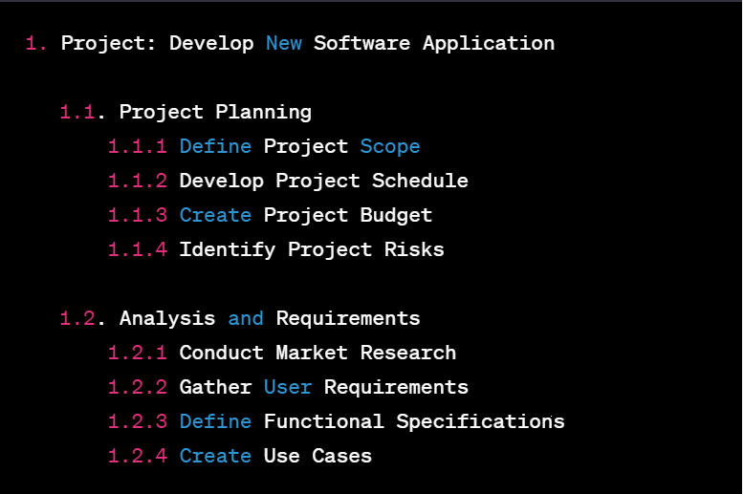

Slide 11
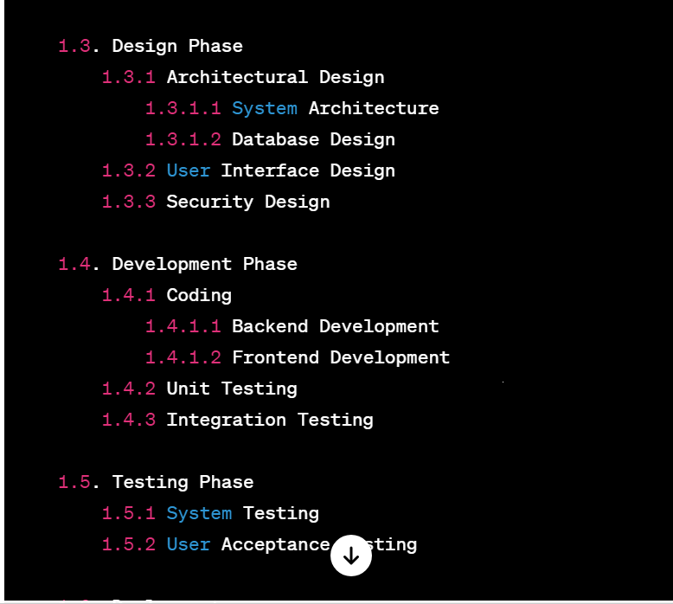

Slide 12
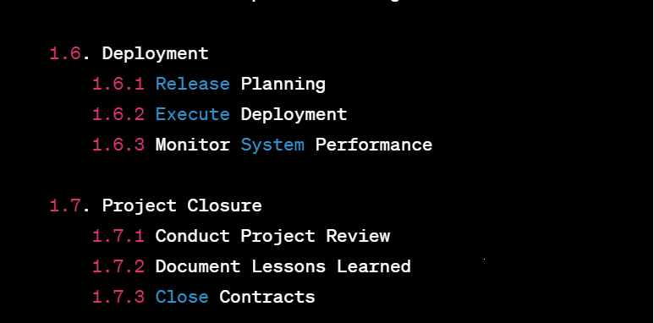

Slide 13
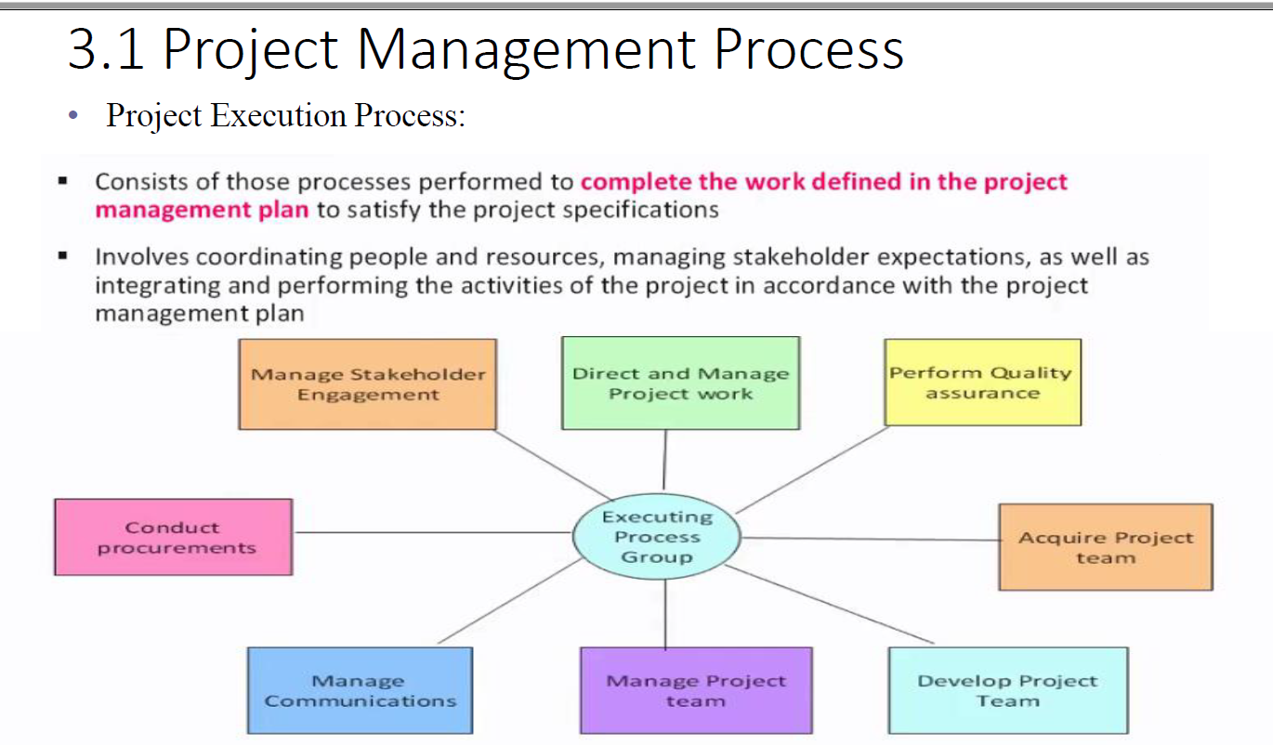

Slide 14
Project monitoring and controling
The Project Monitoring and Controlling phase is a crucial stage in the project management life cycle. It involves tracking, reviewing, and regulating the progress and performance of the project to ensure that project objectives are met.
Monitor and Control Project Work
Track, review, and regulate project performance and progress. This involves comparing actual project performance against the project management plan, identifying variances, and taking corrective actions as needed.
Verify Scope:
Formalize acceptance of the project deliverables. This involves ensuring that the project has delivered what was agreed upon in the scope statement.
Control Scope
Manage changes to the project scope. This involves preventing scope creep and addressing any unauthorized changes to the project scope.
Control Schedule
Monitor and control project schedule performance. This involves comparing planned schedule activities and milestones with the actual progress and taking corrective actions as needed.

Slide 15
Project monitoring and controlling
Control Costs
Monitor and control project costs. This involves tracking project expenditures against the approved budget and making adjustments as necessary.
Perform Quality Control
Monitor and verify that project deliverables meet the specified quality standards. This involves inspecting, testing, and validating project outputs.
Report Performance
Communicate project status and performance to stakeholders. This involves preparing regular performance reports, which may include key performance indicators, progress updates, and forecasts.
Monitor and Control Risks
Continuously assess and respond to project risks. This involves tracking identified risks, implementing risk response plans, and identifying new risks as the project progresses.
Administer Procurements
Manage procurement relationships and contracts. This involves ensuring that vendors are meeting their contractual obligations and addressing any issues that may arise.
Monitor Stakeholder Engagement:
Track stakeholder engagement and adjust strategies as needed. This involves assessing the effectiveness of stakeholder communication and engagement activities.

Slide 16
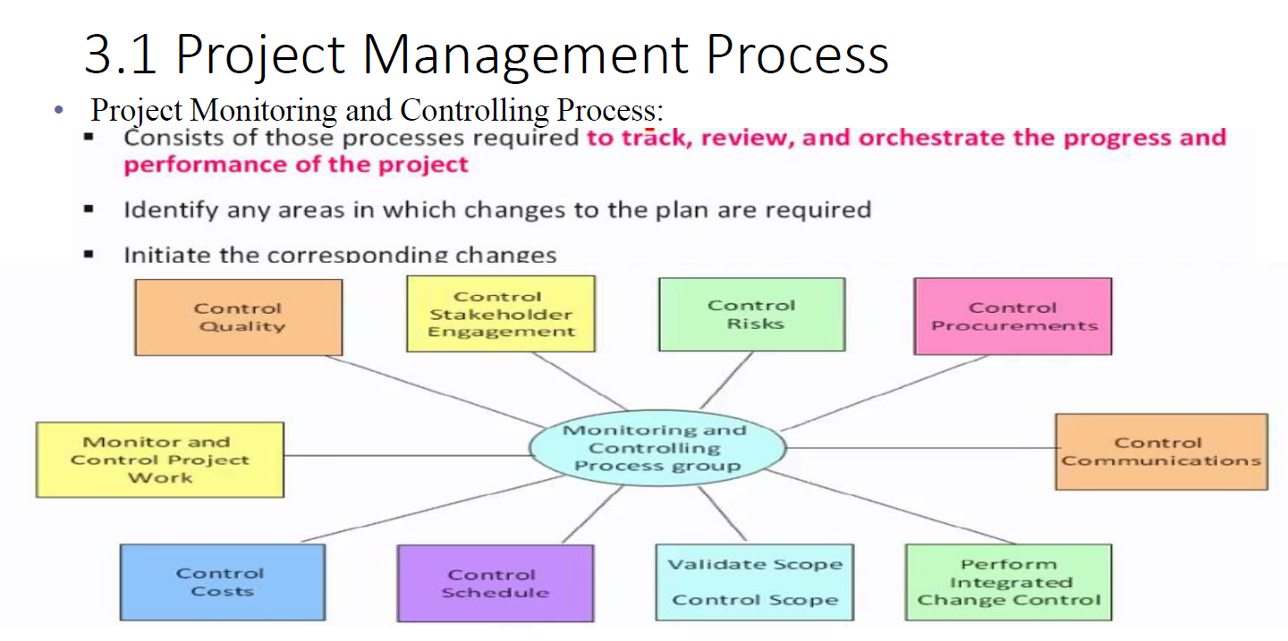

Slide 17
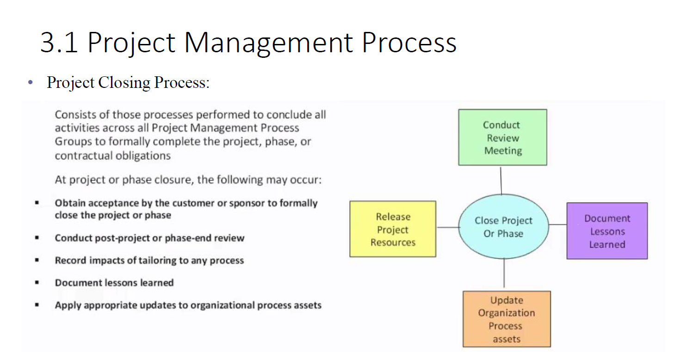

Slide 18
Project Closing
The Project Closing phase is the final stage in the project management life cycle, and it involves completing all project activities, obtaining customer or stakeholder acceptance, and formally closing out the project.
Close Project or Phase
Finalize all project activities, deliverables, and documentation. Obtain formal acceptance from the customer or stakeholders that the project objectives have been met.
Close Procurements
Complete and settle any remaining procurements. This involves ensuring that all contractual obligations have been met, final payments are made, and contracts are officially closed.
Perform Final Performance Reporting
Summarize and communicate the final project performance. This involves comparing planned performance with actual performance and documenting key project metrics and achievements.
Archive Project Documents
Organize and store all project documentation in a central repository. This involves archiving project plans, reports, contracts, and other relevant documents for future reference.

Slide 19
Project Closing
Obtain Formal Acceptance:
Obtain formal acceptance of the project deliverables from the customer or stakeholders. This involves ensuring that the project has met the agreed-upon criteria and that all parties are satisfied with the outcomes.
Release Project Resources
Release project team members and resources. This involves formally notifying team members of their completion of project assignments and releasing any project-related resources, such as equipment or facilities.
Close Out Contracts
Complete and close out all contractual agreements related to the project. This involves settling any outstanding contractual issues, making final payments, and obtaining formal closure from vendors or suppliers.
Conduct Post-Implementation Review:
Evaluate the project's overall success and performance. This involves conducting a post-implementation review to identify lessons learned, best practices, and areas for improvement.

Slide 20
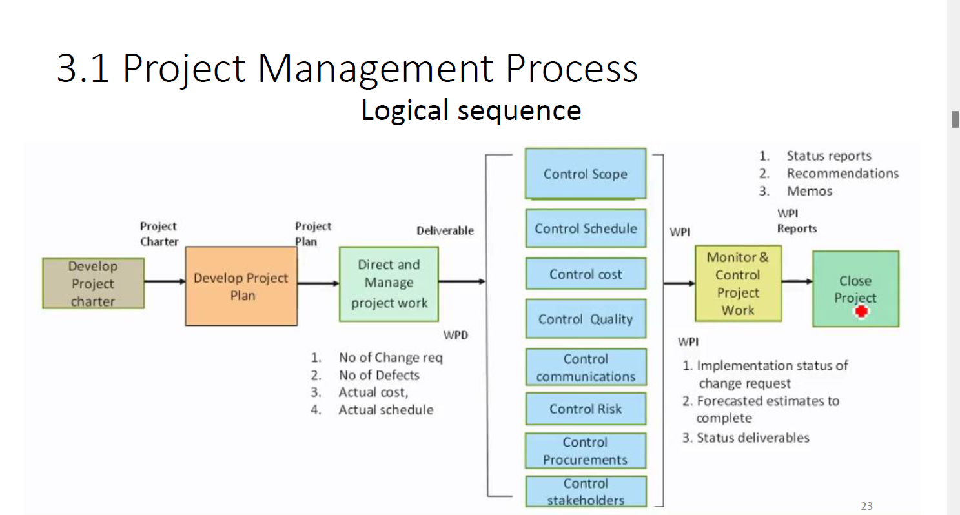

Slide 21
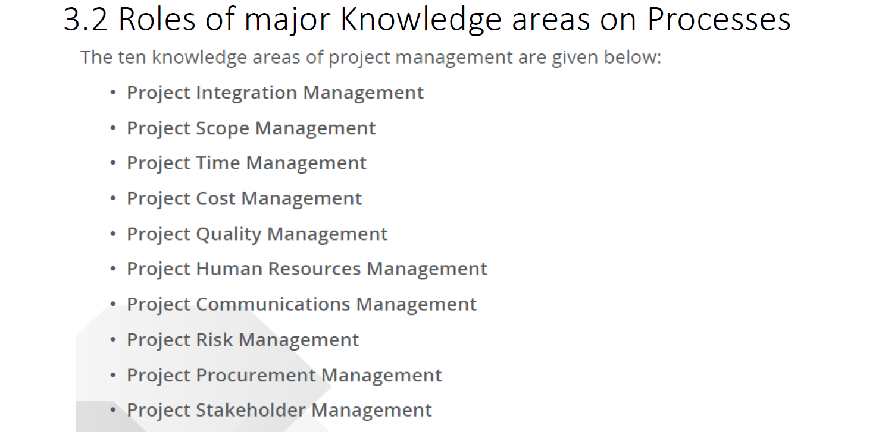

Slide 22
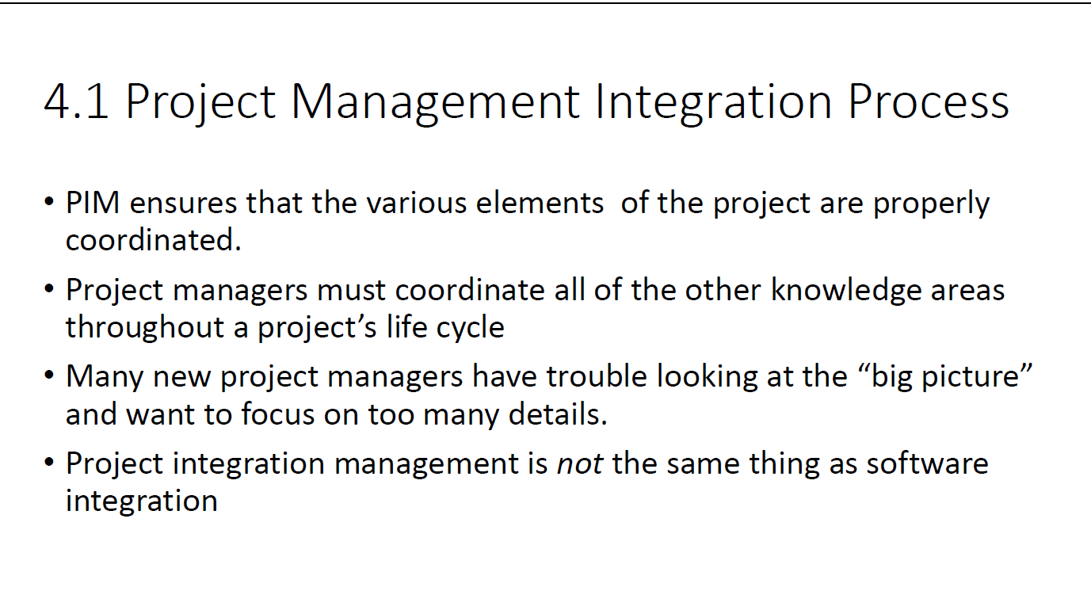

Slide 23
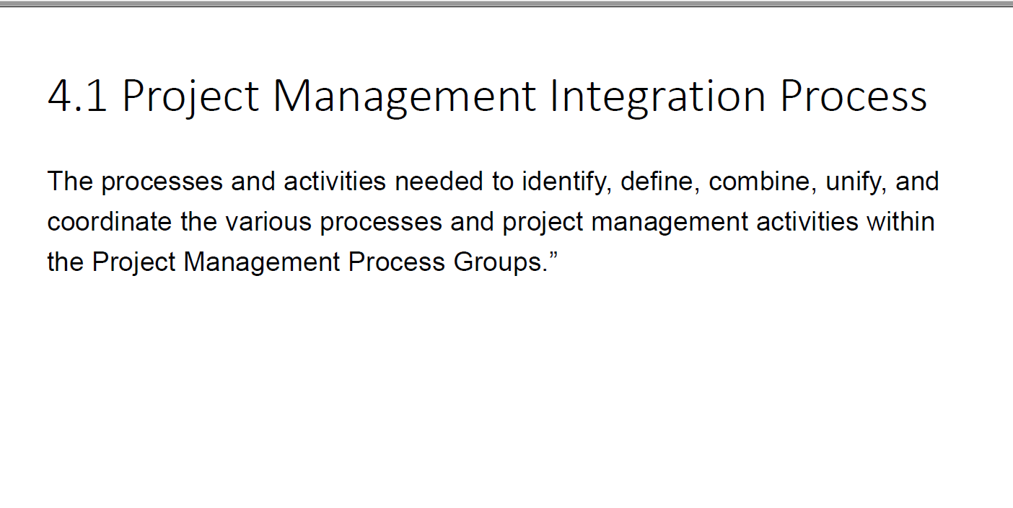

Slide 24
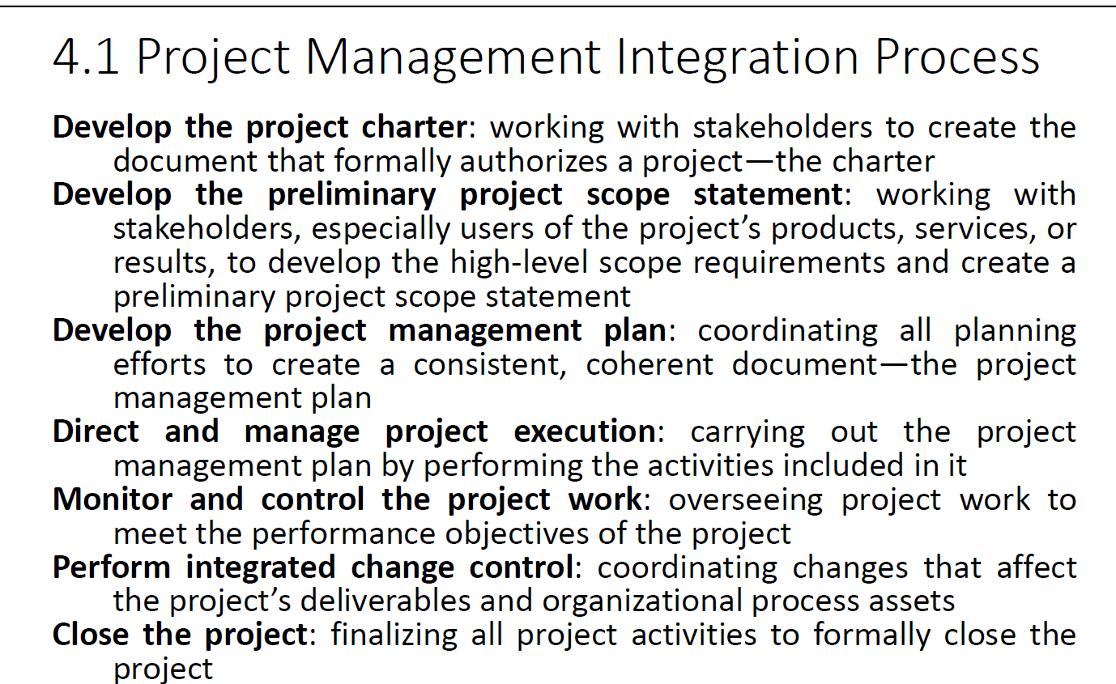

Slide 25
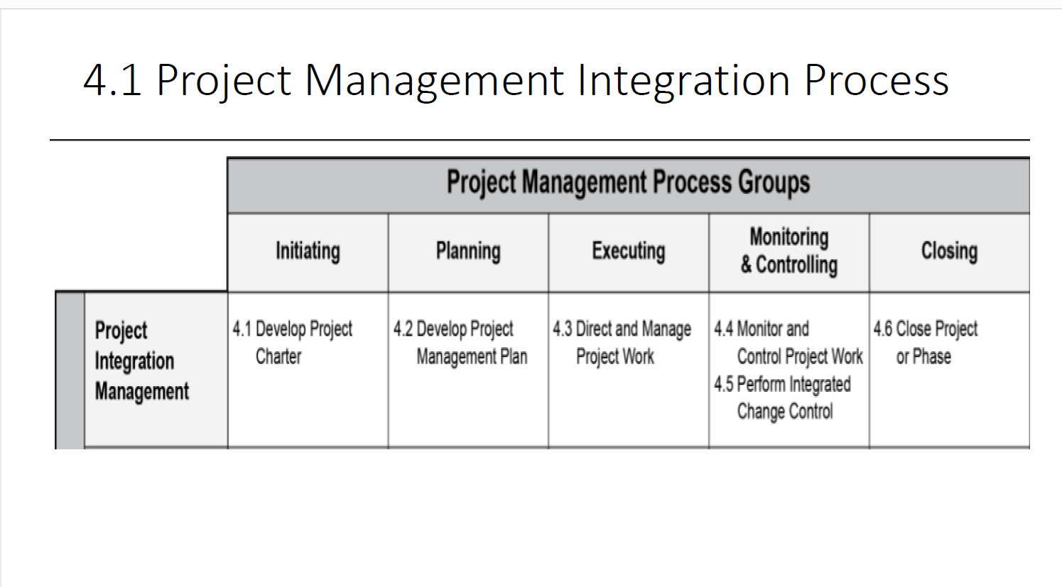

Slide 26
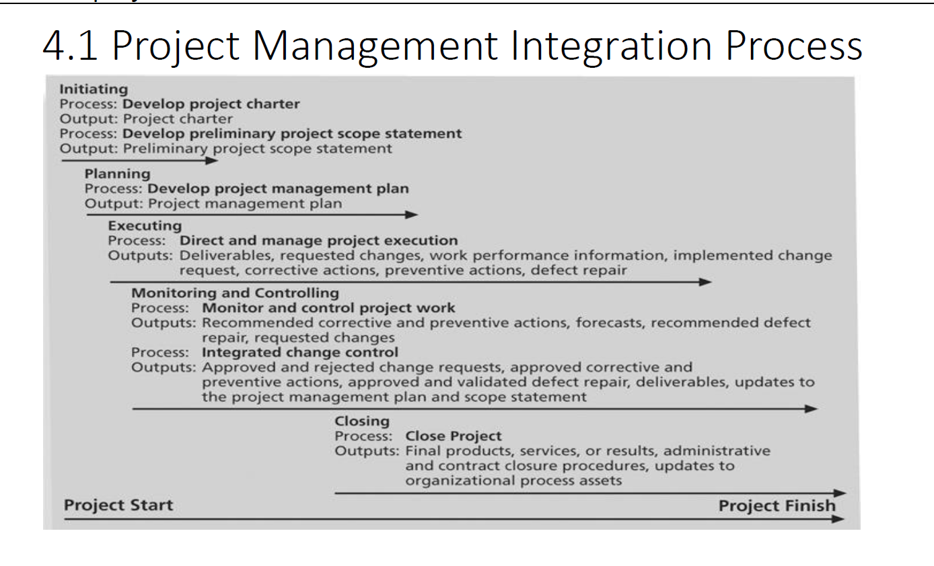

Slide 27
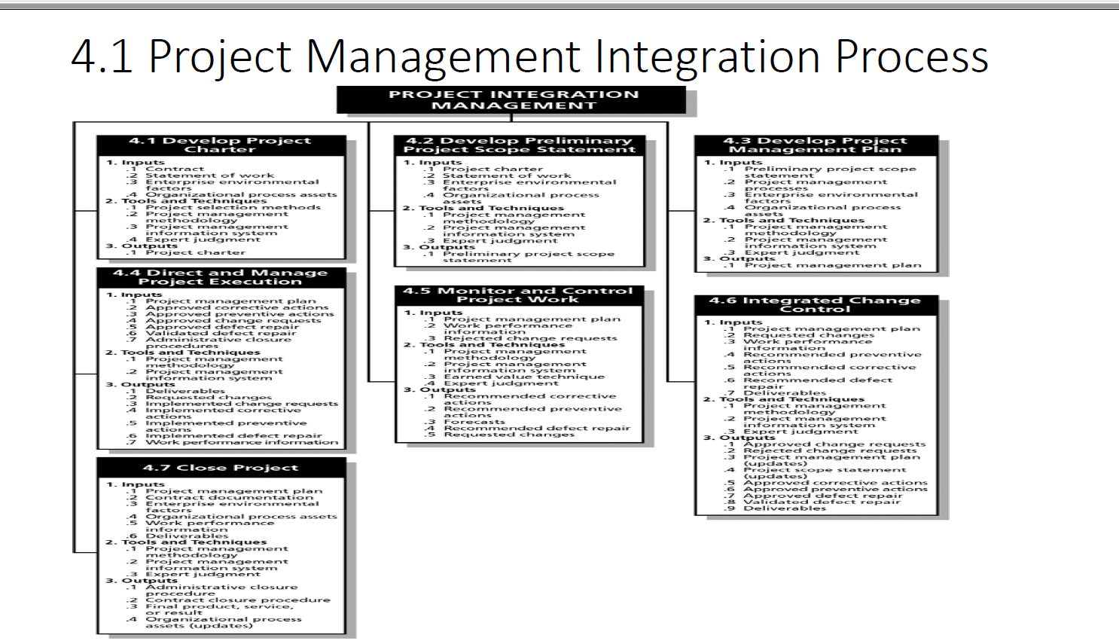

Slide 28
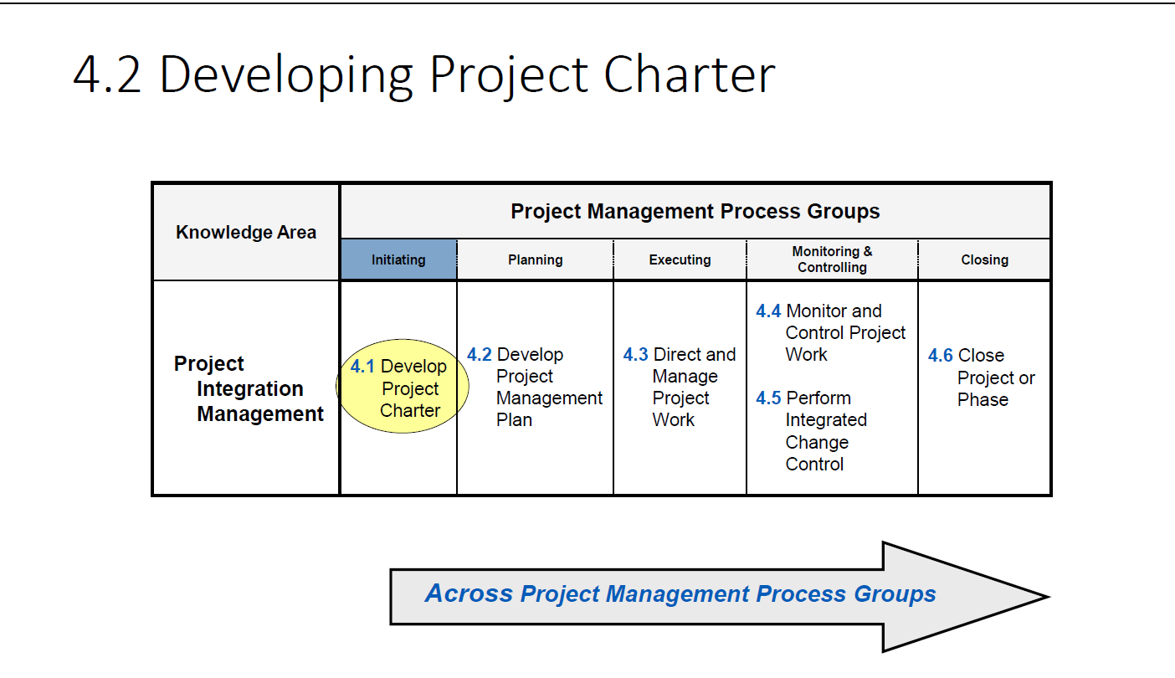

Slide 29
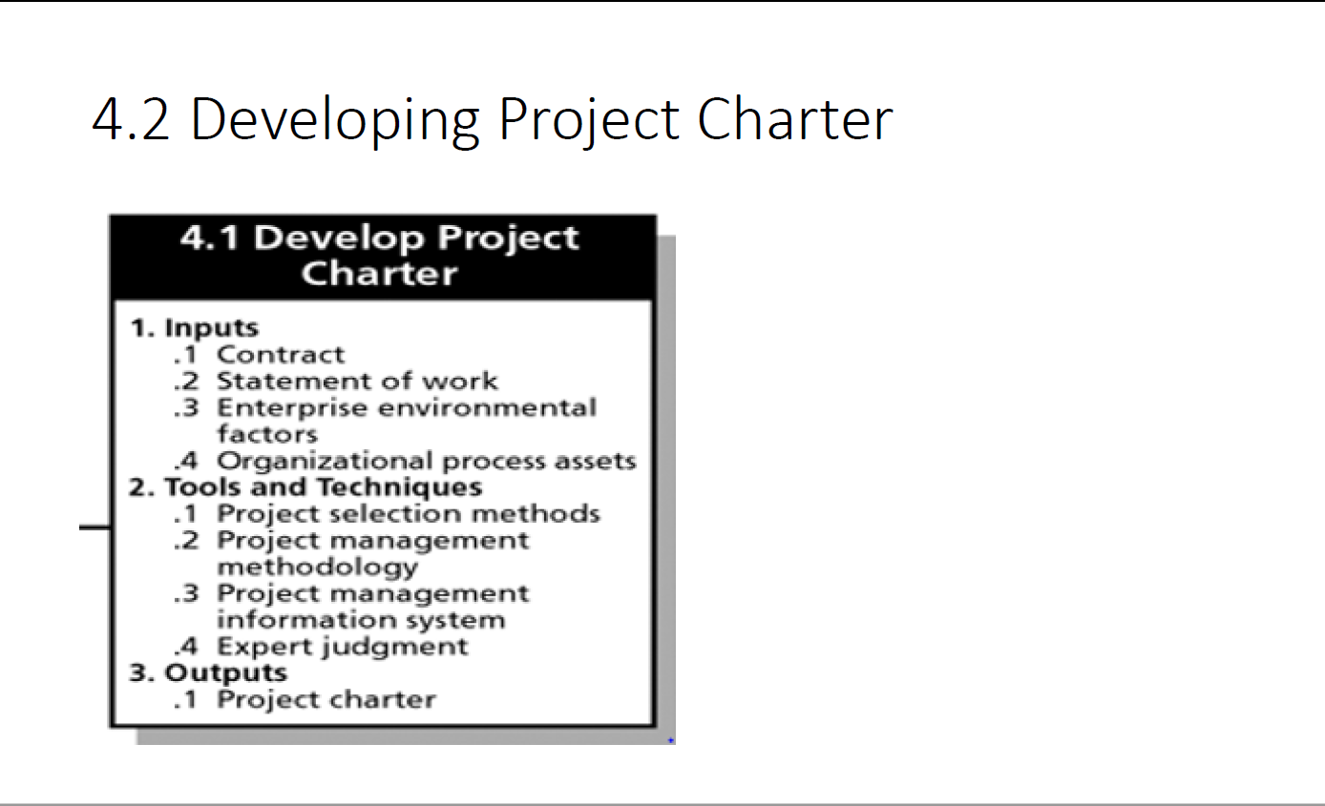

Slide 30
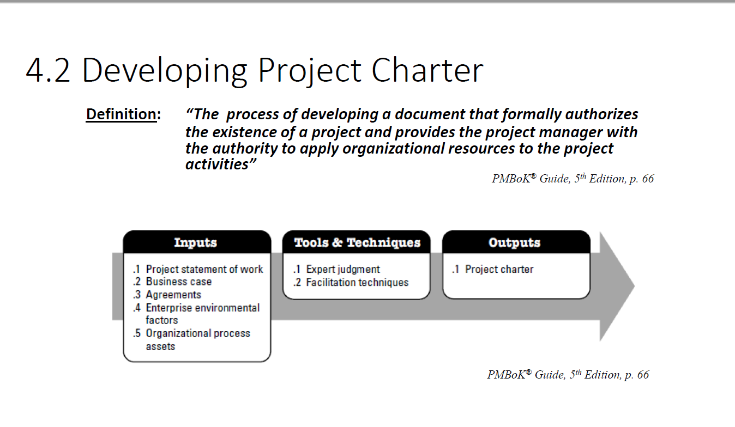

Slide 31
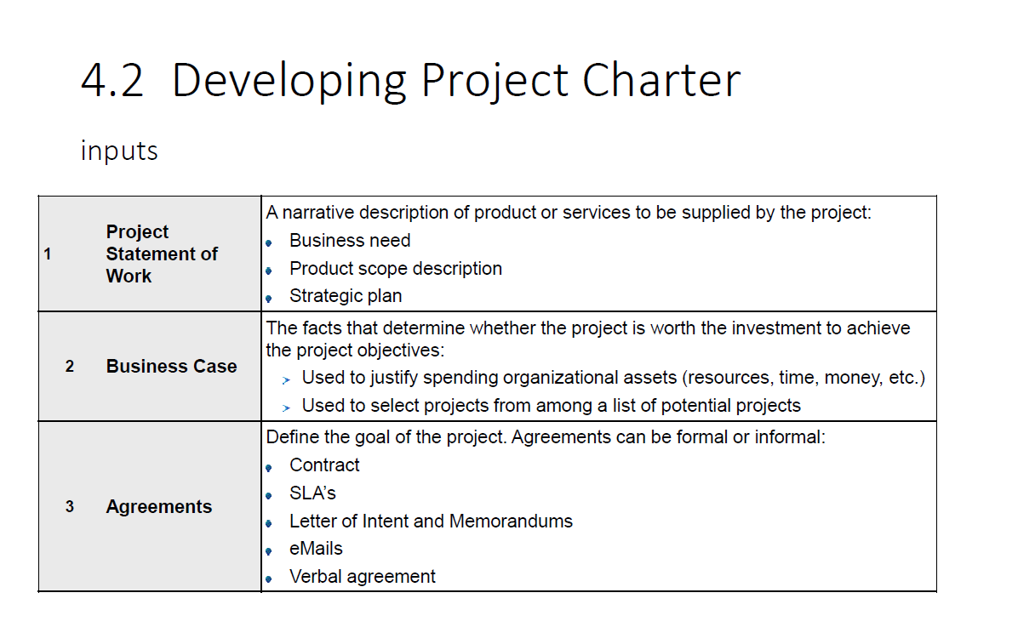

Slide 32
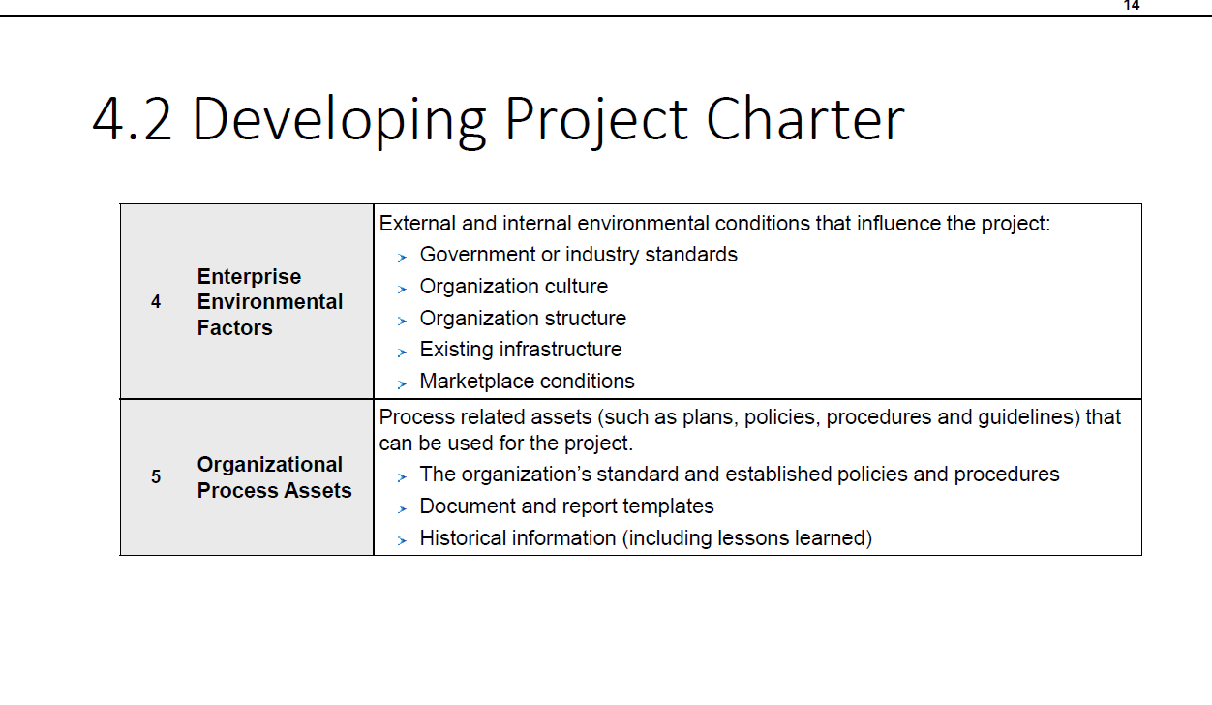

Slide 33
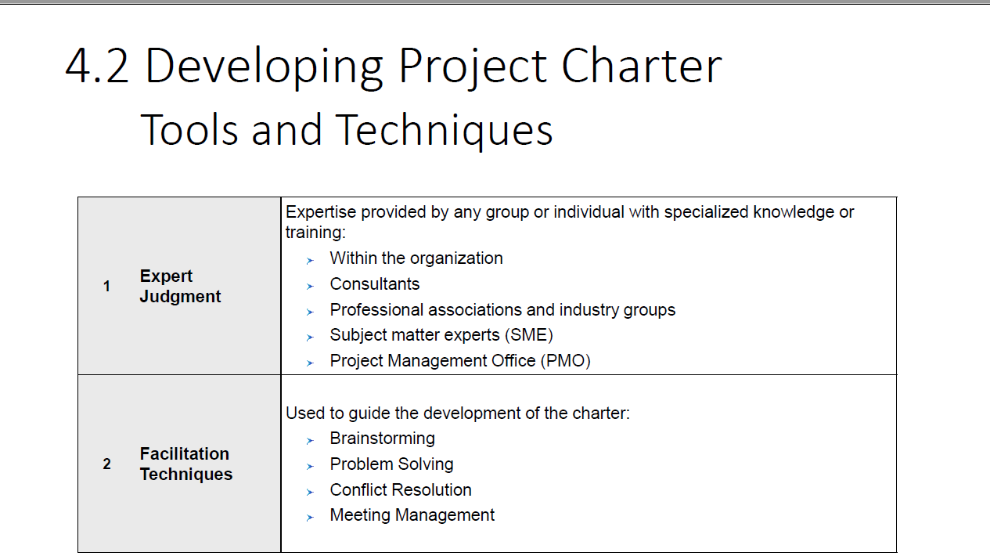

Slide 34
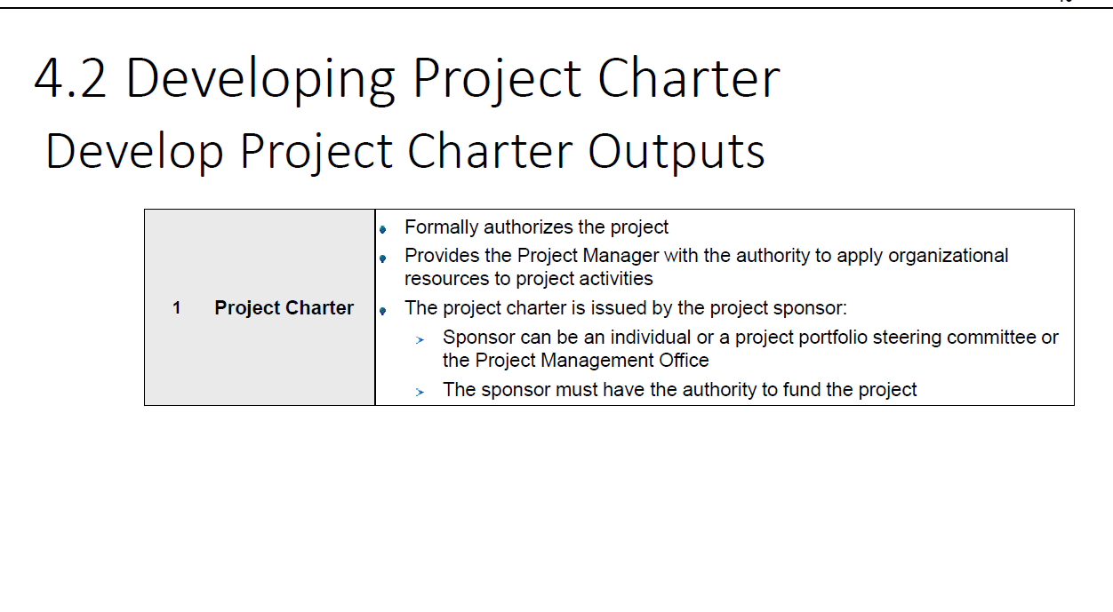

Slide 35
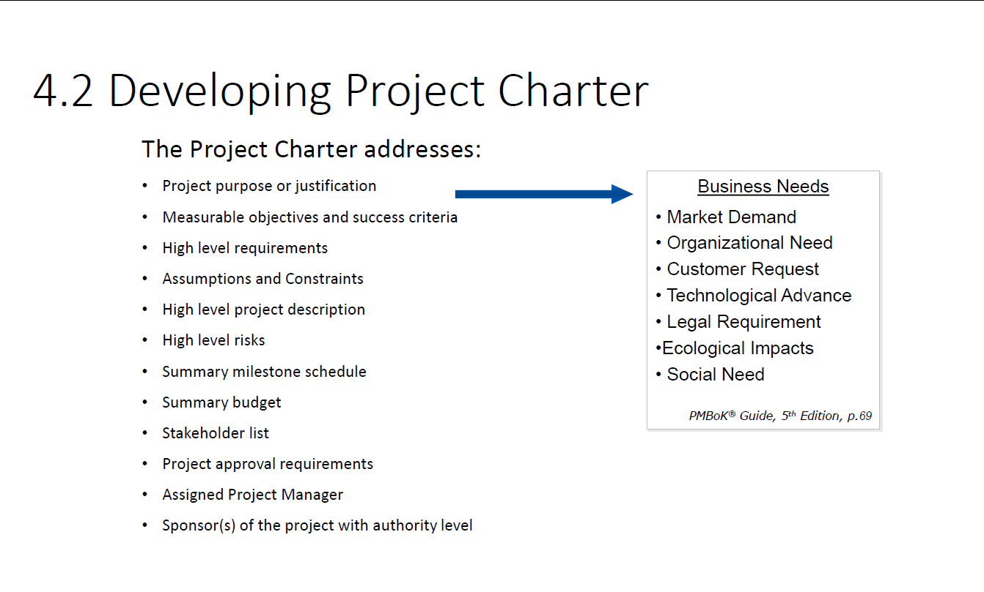

Slide 36
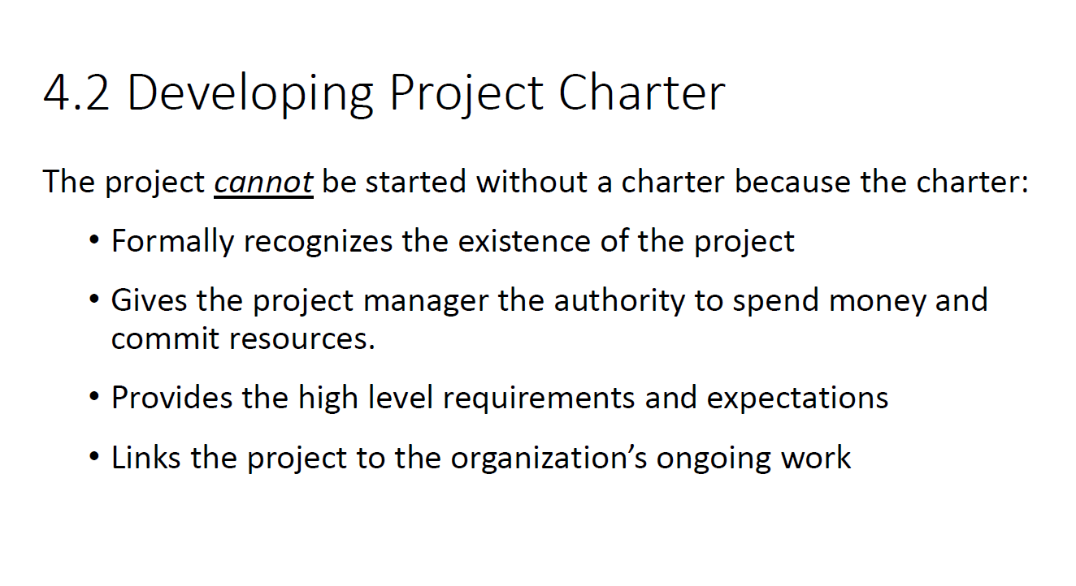

Slide 37
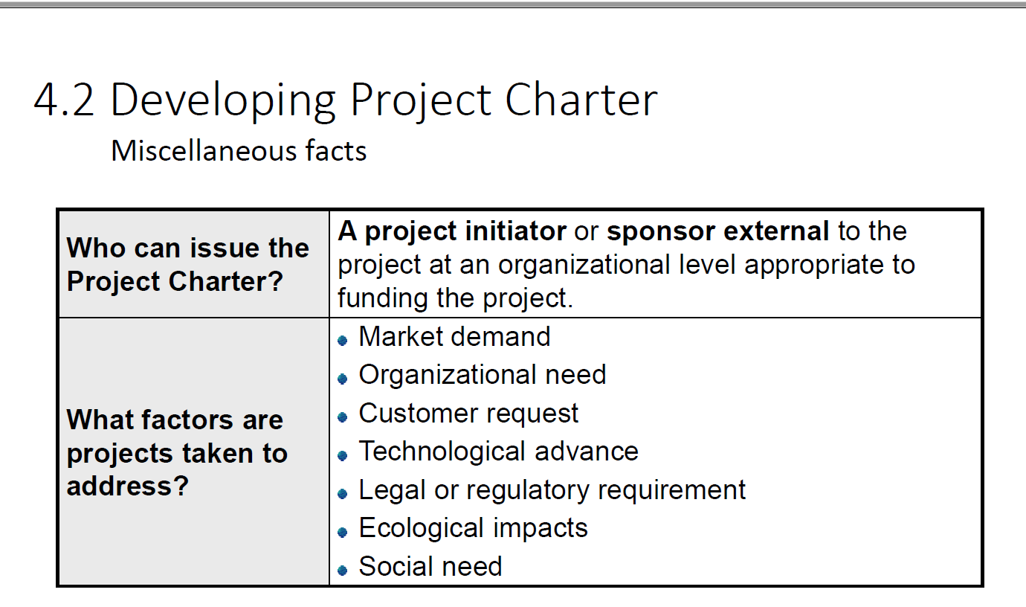

Slide 38
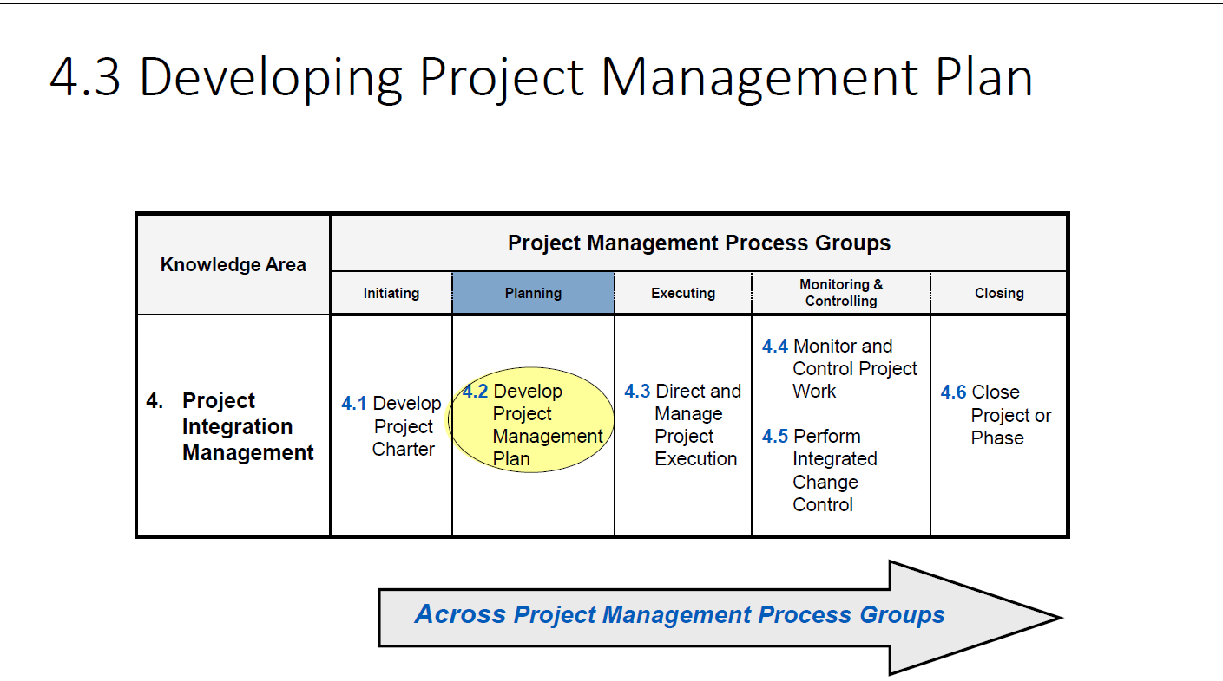

Slide 39
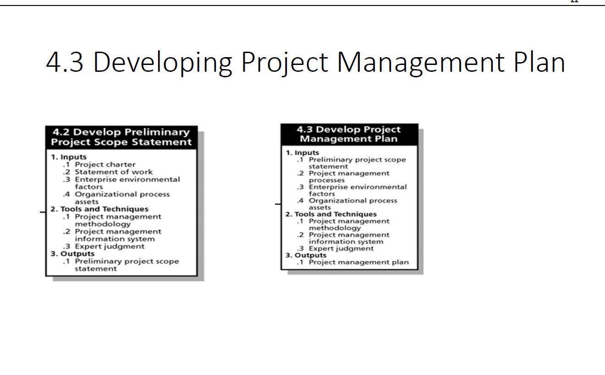

Slide 40
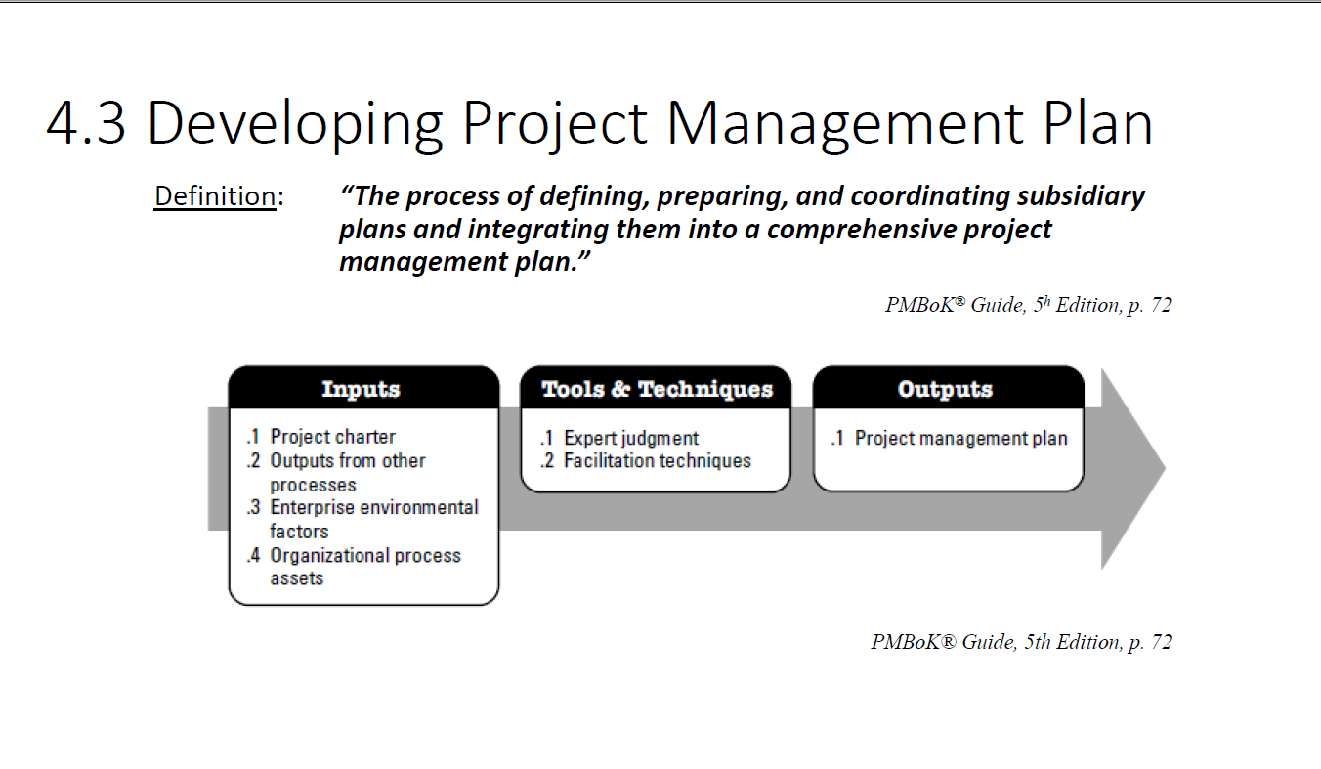

Slide 48
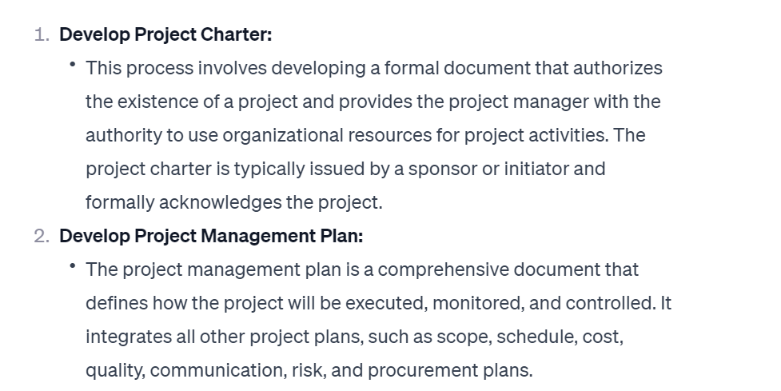

Slide 49
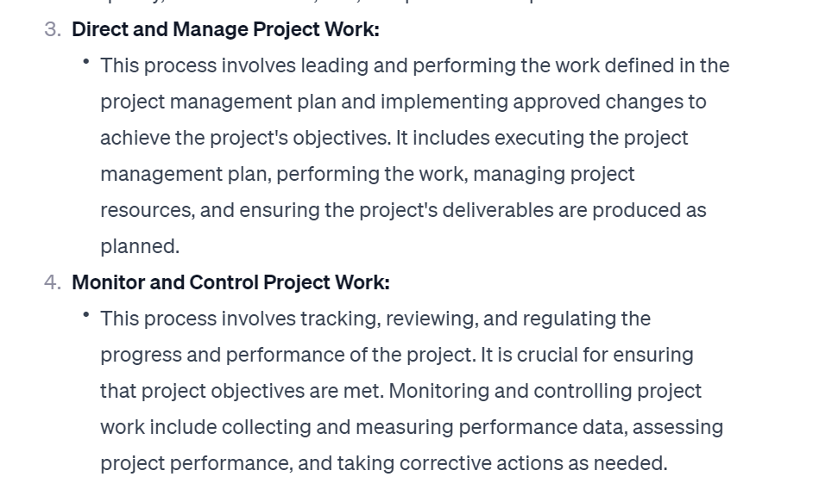

Slide 50
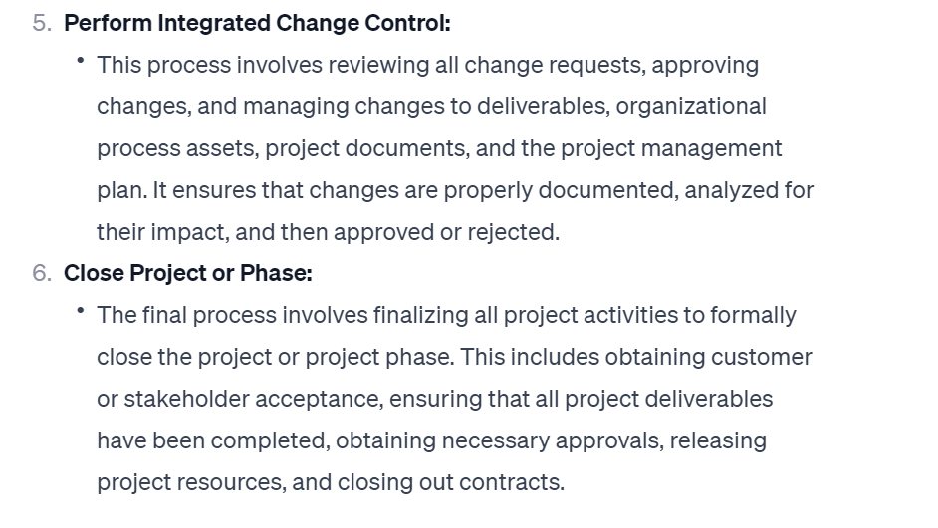

Slide 51
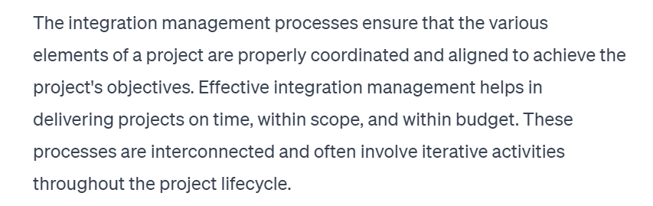

Slide 52
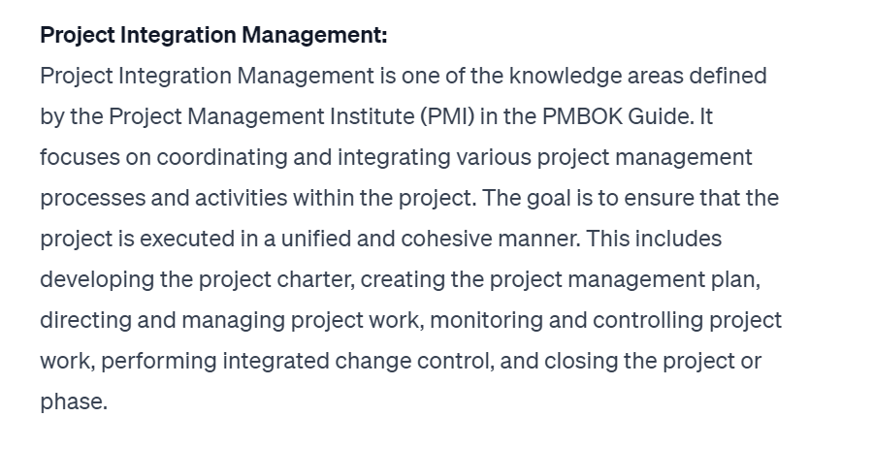

Slide 53
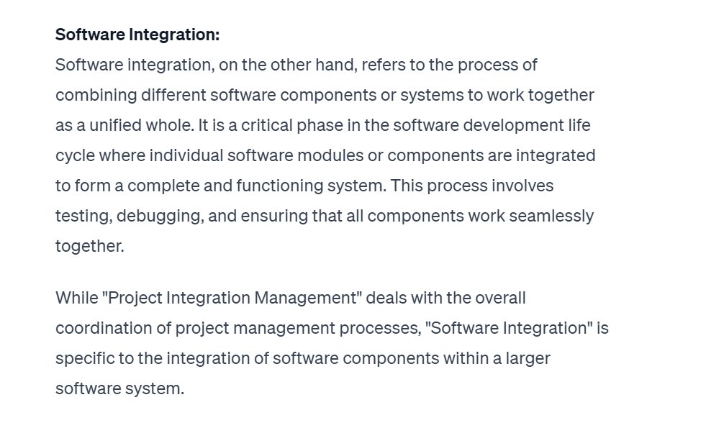

Slide 67
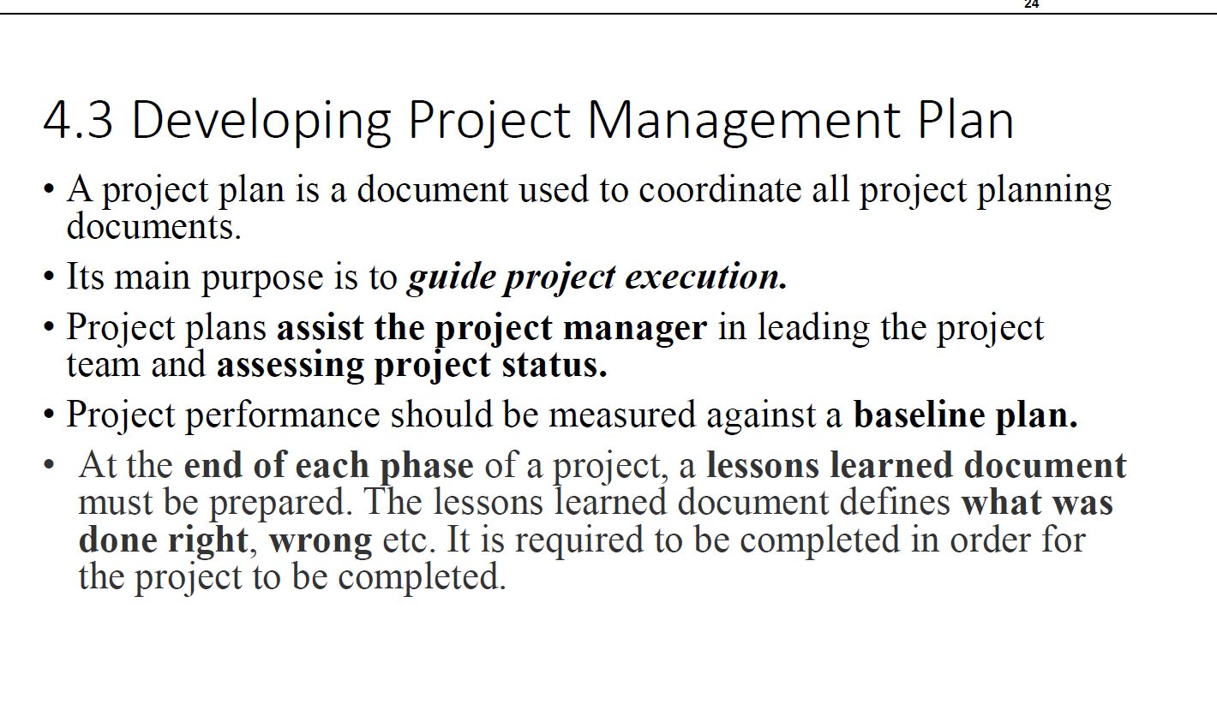

Slide 68
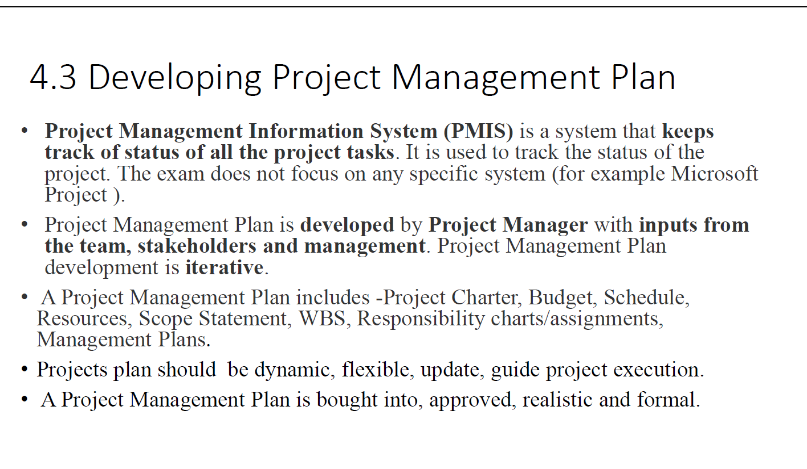

Slide 69
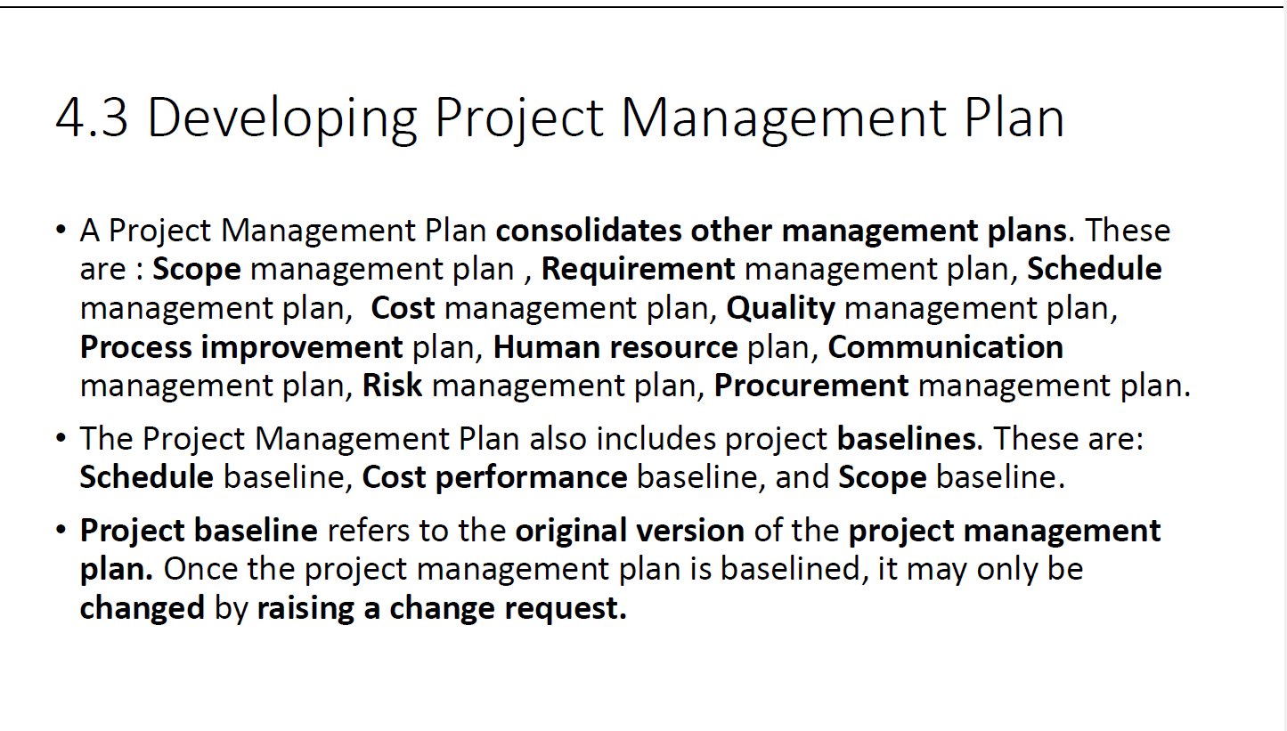

Slide 70
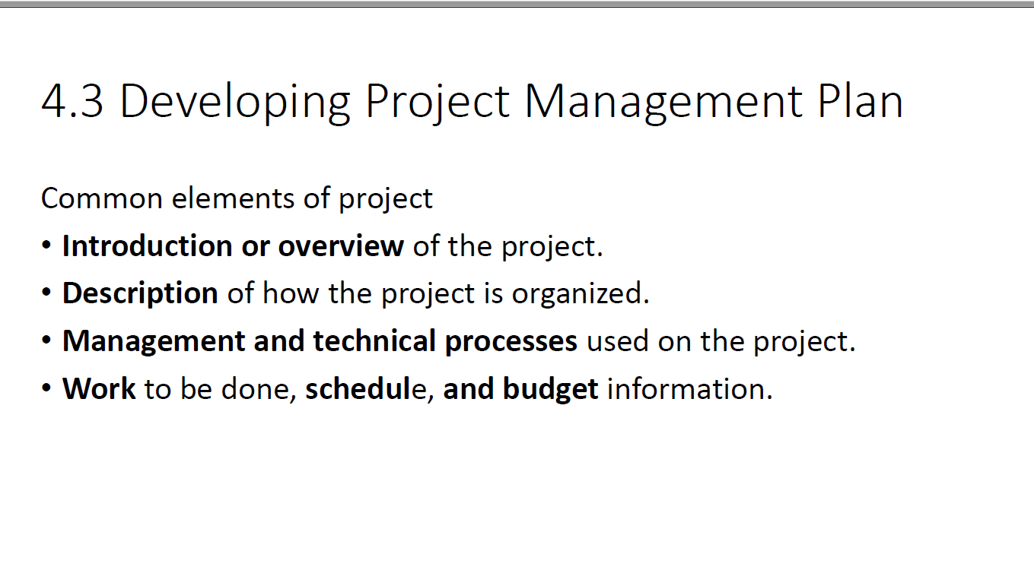

Slide 71
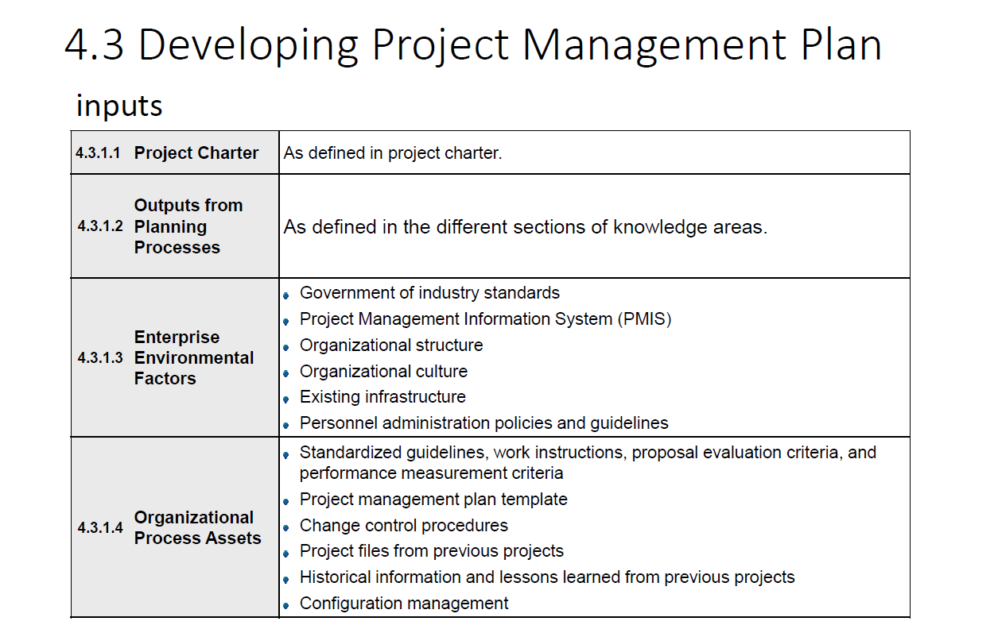

Slide 72
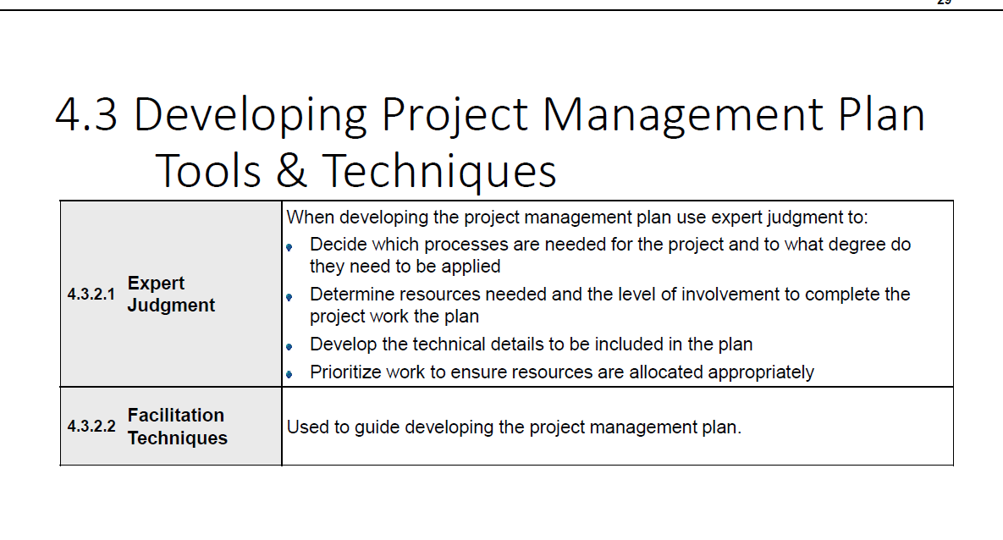

Slide 73
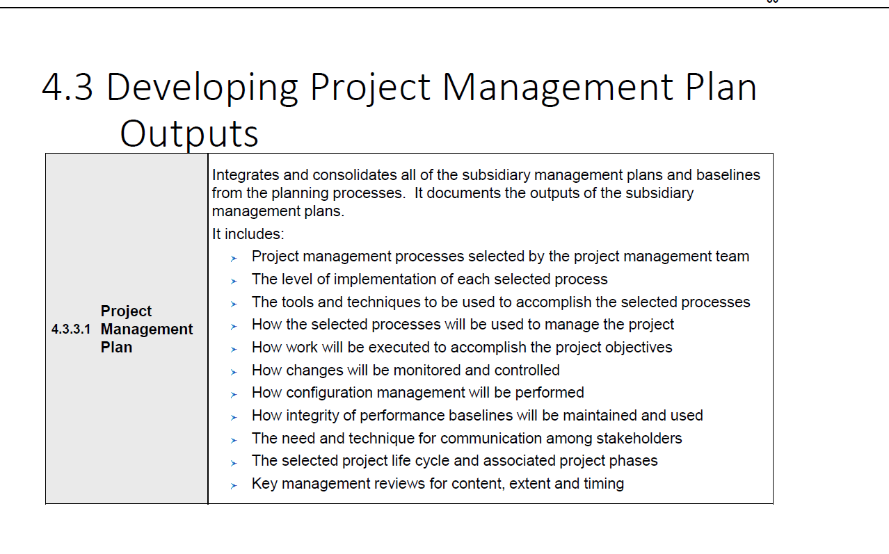

Slide 74
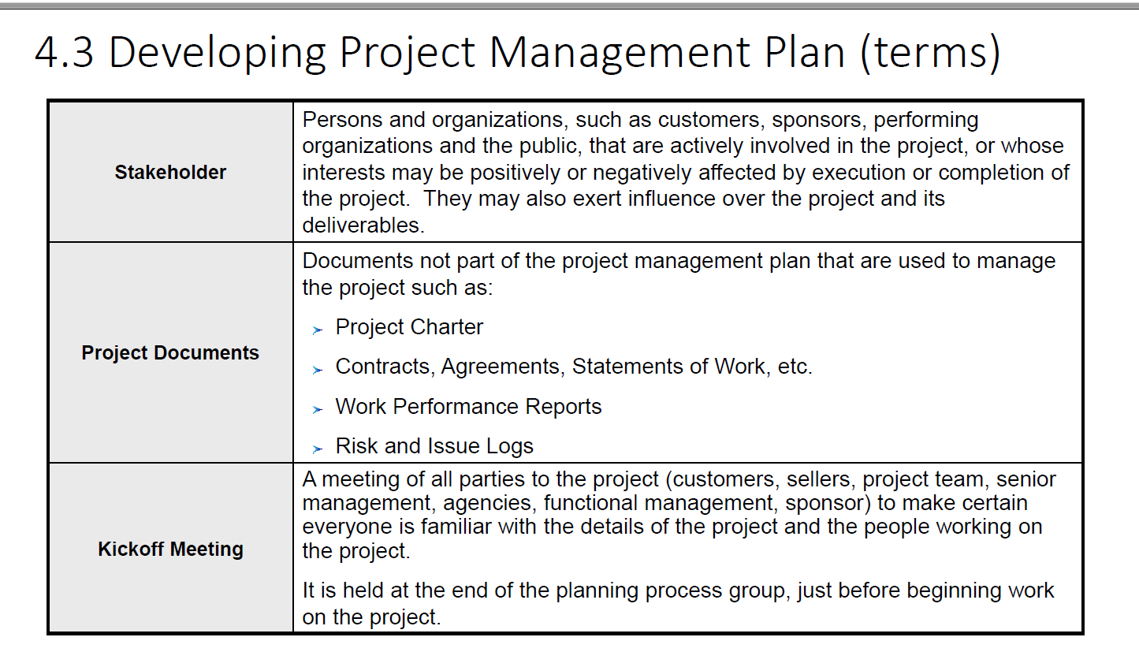

Slide 75
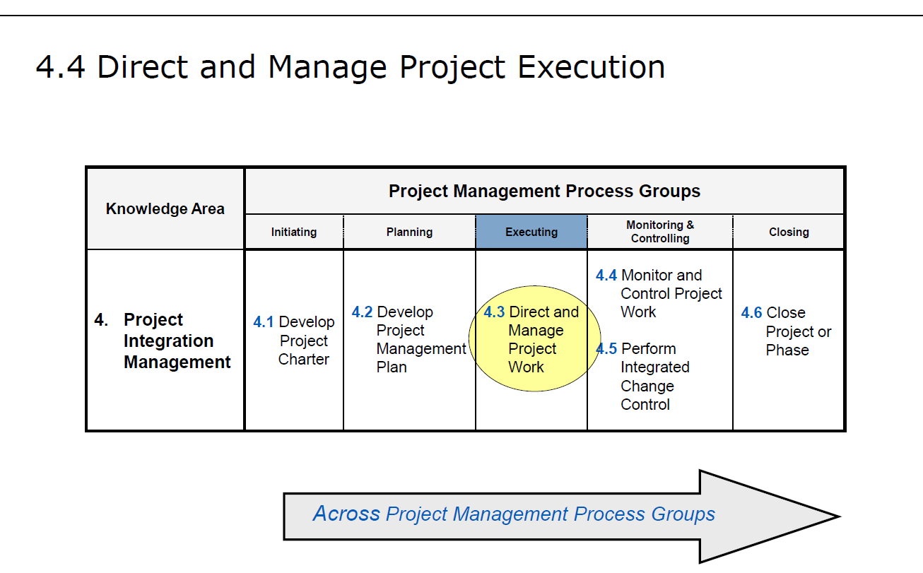

Slide 76
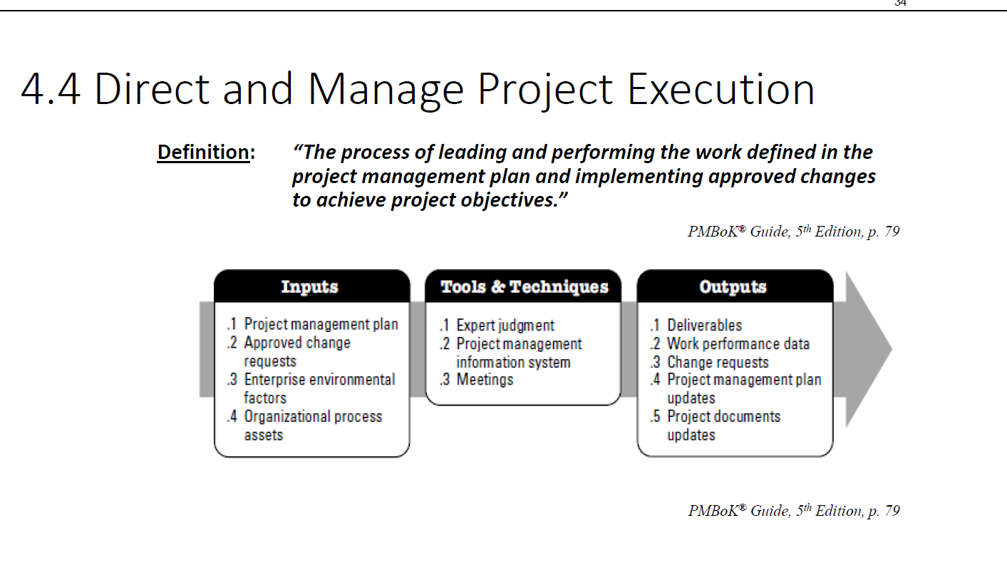

Slide 77
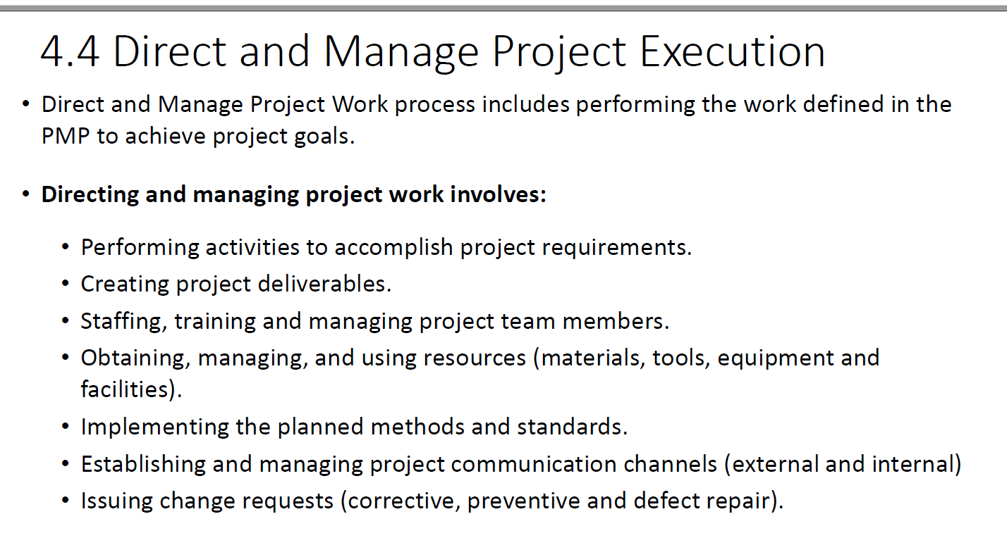

Slide 78
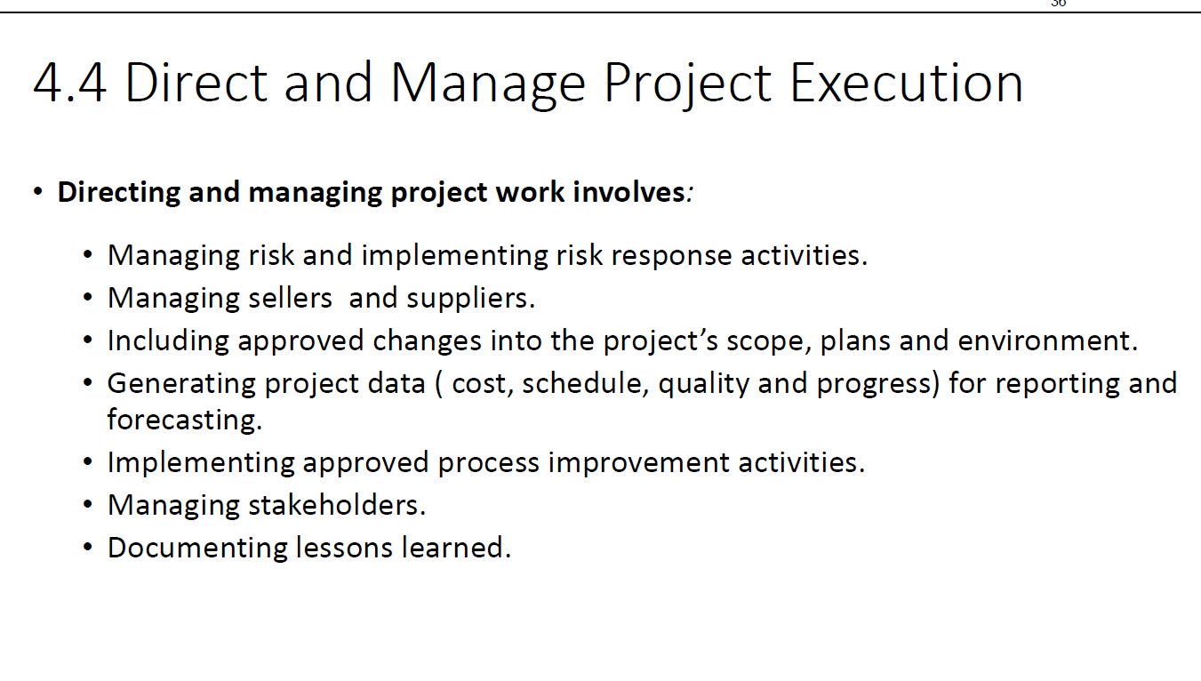

Slide 79
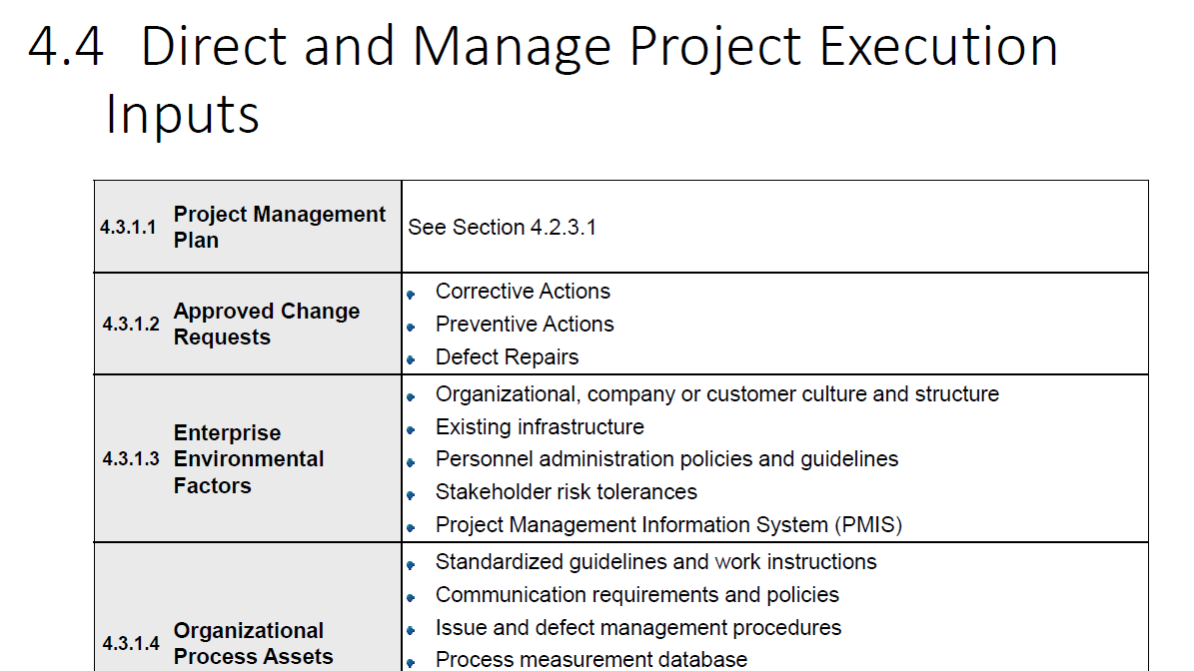

Slide 80


Slide 81


Slide 82


Slide 83


Slide 84


Slide 85


Slide 86


Slide 87


Slide 88


Slide 89


Slide 90


Slide 91


Slide 92


Slide 93


Slide 94


Slide 95


Slide 96


Slide 97


Slide 98


Slide 99


Slide 100


Slide 101


Slide 102


Slide 103


Slide 104


Slide 105
Project Integration Management
Project Integration Management is one of the ten knowledge areas defined in the PMBOK (Project Management Body of Knowledge). It encompasses processes and activities that integrate all aspects of a project, ensuring that the project components are coordinated effectively to achieve the overall objectives. This involves managing resources, stakeholders, and deliverables to maintain alignment with the project's scope, schedule, and budget.
Ensures Alignment with Objectives: Integration management ensures that all project elements are aligned with the business objectives and project goals, minimizing risks of scope creep and mismanagement.
Facilitates Coordination: By integrating processes, it ensures that different teams and departments work cohesively, reducing redundancies and inefficiencies.
Manages Complexity: In projects with multiple components, integration management simplifies complex interdependencies by creating a unified strategy.
Enables Effective Change Management: The process ensures that all changes are evaluated for their impact on the project and are implemented in a controlled manner.
Optimizes Resources: It ensures that resources (time, budget, and personnel) are allocated effectively and are used to their maximum potential.
Provides a Comprehensive View: Integration management offers a holistic view of the project, helping stakeholders understand its progress and interdependencies.

Slide 106
PIM
“Project Integration Management includes the processes and activities to identify, define, combine, unify, and coordinate the various processes and project management activities within the Project Management Process Groups.”- A Guide to the Project Management Body of Knowledge (PMBOK 6)
In other words, project integration management is an organized approach that ensures all processes within a project are synchronized and executed efficiently, and resources remain on track to achieve the project goals. It helps us to balance stakeholder expectations and customer needs while optimizing tasks and resources, steering the project toward success.

Slide 107
PI vs PM
Feature | Project Management | Project Integration
Focus | Overall organization and execution of a project | Connecting and coordinating different parts of a project
Scope | Broad: Initiating, planning, executing, monitoring, closing a project | Narrow: Ensuring seamless collaboration and interaction between project elements
Responsibilities | Define goals, manage resources, schedule tasks, control risks, etc. | Align tasks, resolve conflicts, manage dependencies, optimize workflow, etc.
Example | Launching a new product, building a website, running an event | Integrating new software into existing systems, merging departments for a common goal
Key Skill | Leadership, planning, decision-making, communication | Collaboration, problem-solving, adaptability, critical thinking

Slide 108


Slide 109


Slide 110
Project Integration Management
It focuses on ensuring that the various elements of a project are properly coordinated. The processes in this knowledge area span all phases of a project and involve combining, unifying, and integrating the project management processes across the project lifecycle.
1. Develop Project Charter
Purpose: Formally authorize the project and document initial requirements.
Key Inputs:
Business documents (e.g., business case)
Agreements
Enterprise Environmental Factors (EEF)
Organizational Process Assets (OPA)
Key Outputs:
Project charter
Assumption log

Slide 111


Slide 112


Slide 113


Slide 114


Slide 115


Slide 116


Slide 117
Project Integration Management
Tools & Techniques
Expert judgment
Data gathering
Brainstorming
Focus groups
Interviews
Interpersonal and team skills
Conflict management
Facilitation
Meeting management
Meetings

Slide 118
Project Integration Management
2. Develop Project Management Plan
Purpose: Define how the project will be executed, monitored, controlled, and closed.
Key Inputs:
Project charter
Outputs from other planning processes
EEF
OPA
Key Outputs:
Project management plan

Slide 119
Project Integration Management
Tools & Techniques
Expert judgment
Data gathering
Brainstorming
Checklists
Focus groups
Interviews
Interpersonal and team skills
Conflict management
Facilitation
Meeting management
Meetings

Slide 120
Project Integration Management
3. Direct and Manage Project Work
Purpose: Perform the work defined in the project management plan and achieve the project's objectives.
Key Inputs:
Project management plan
Project documents (e.g., change log, issue log)
Approved change requests
EEF
OPA
Key Outputs:
Deliverables
Work performance data
Issue log
Change requests
Updates to project documents and plans

Slide 121
Work Performance Data
Work performance data is the raw, unprocessed data and observations collected during project execution. This data is gathered through project work activities and serves as the foundation for generating insights about the project's status. It provides factual, quantitative information and is used as an input to processes that analyze and transform it into useful information.
Characteristics of Work Performance Data
Raw: It has not yet been analyzed or interpreted.
Quantitative: Includes measurable metrics such as start and finish dates, costs, and resource usage.
Collected During Execution: It is gathered as project activities are carried out.

Slide 122
Work Performance Data
Examples of Work Performance Data
Schedule Data:
Actual start and finish dates of tasks.
Number of tasks completed versus scheduled.
Cost Data:
Actual cost incurred for resources.
Cost of work performed to date.
Scope Data:
Percentage of work completed.
Number of change requests submitted.
Quality Data:
Number of defects identified during testing.
Results of quality control measurements.
Resource Data:
Resource utilization rates.
Hours worked by team members.

Slide 123
Project Integration Management
Tools & Techniques
Expert judgment
Project management information system
Meetings

Slide 124
Project Integration Management
4. Manage Project Knowledge
Purpose: Use existing knowledge and create new knowledge to achieve project objectives and contribute to organizational learning.
Key Inputs:
Project management plan
Project documents (e.g., lessons learned register)
Deliverables
EEF
OPA
Key Outputs:
Lessons learned register
Updates to project management plan and OPA

Slide 125
Project Integration Management
Tools & Techniques
Expert judgment
Knowledge management
Information management
Interpersonal and team skills
Active listening
Facilitation
Leadership
Networking
Political awareness

Slide 126
Project Integration Management
5. Monitor and Control Project Work
Purpose: Track, review, and report project progress to meet performance objectives.
Key Inputs:
Project management plan
Project documents (e.g., assumption log, risk register)
Work performance information
Agreements
EEF
OPA
Key Outputs:
Work performance reports
Change requests
Updates to project documents and plans

Slide 127
Project Integration Management
Tools & Techniques
Expert judgment
Data analysis
Alternatives analysis
Cost-benefit analysis
Earned value analysis
Root cause analysis
Trend analysis
Variance analysis
Decision making
Meetings

Slide 128
Project Integration Management
6. Perform Integrated Change Control
Purpose: Review all change requests, approve/reject changes, and update project documents and plans accordingly.
Key Inputs:
Project management plan
Project documents (e.g., change log)
Work performance reports
Change requests
EEF
OPA
Key Outputs:
Approved change requests
Updates to project management plan and project documents

Slide 129
Project Integration Management
Tools & Techniques
Expert judgment
Change control tools
Data analysis
Alternatives analysis
Cost-benefit analysis
Decision making
Voting
Autocratic decision making
Multicriteria decision analysis
Meetings

Slide 130
Project Integration Management
7. Close Project or Phase
Purpose: Finalize all project activities to formally close the project or a phase.
Key Inputs:
Project charter
Project management plan
Project documents (e.g., lessons learned register)
Accepted deliverables
Business documents (e.g., business case)
Agreements
OPA
Key Outputs:
Final product, service, or result transition
Project documents updates
OPA updates

Slide 131
Project Integration Management
Tools & Techniques
Expert judgment
Data analysis
Document analysis
Regression analysis
Trend analysis
Variance analysis
Meetings

